Slide 1
COMPUTER

Slide 2
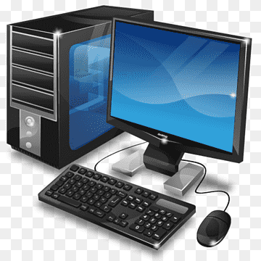

Slide 3
CONTENT
Classification of computer
Hardware
Introduction
Software
Input devices
Output devices
Usage of computer

Slide 4
INTRODUCTION
A computer is an electronic device that takes data and instruction is an input from the user, processes data, and provide useful information known as output. This cycle of operation of a computer is known as the input- process- output cycle and as in shown in figure.

Slide 5
CLASSIFICATION OF COMPUTER
Computer is classified into several categories depending on their computing ability and processing speed. These include
Microcomputer
Minicomputer
Mainframe computer
Supercomputer

Slide 6
HARDWARE
The electronic device is known as hardware.
Computer hardware is the physical part of the computer system, the machinery and equipment.
Parts of the computer “you can feel”
Internal hardware devices include motherboards, hard drives, and RAM. External hardware includes monitor, keyboard, mice, printer and scanner.

Slide 7
SOFTWARE
Software is the collection of computer program and related data that provide the instructions for telling a computer what to do and how to do. In other words, software is a conceptual entity which is a set of computer programs , procedures, and associated documentation concern with the operation of a data processing system. We can also say software refers to one or more computer programs and data held in the storage of the computer for some purposes.

Slide 8
INPUT DEVICES
Input device capture information and translate it into a form that can be processed and use by other parts of your computer. Input devices like- keyboard, mouse, light pen, microphone etc.

Slide 9
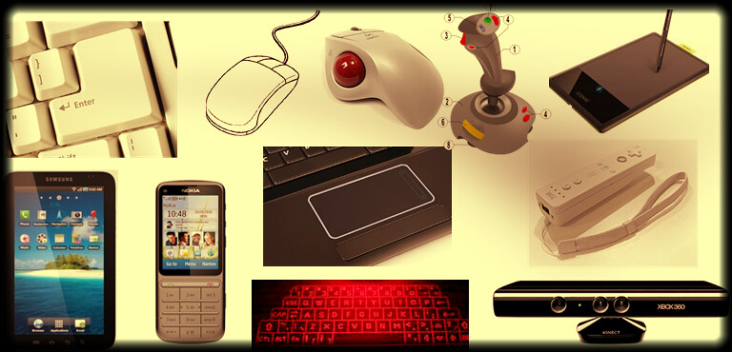
INPUT DEVICES PICTURE

Slide 10
OUTPUT DEVICES
Output devices take information within your computer and present it to you in a form that you can understand. Output devices like- monitor, printer, headphone, speaker, plotter, projector etc.

Slide 11
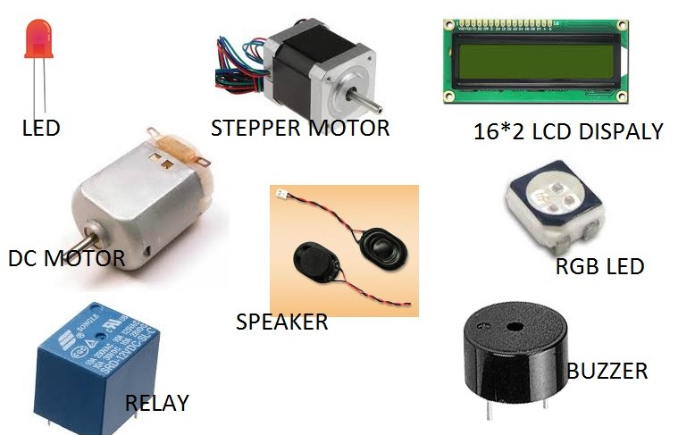
OUTPUT DEVICES PICTURE

Slide 12
USAGE OF COMPUTER
Computer is the best companion parts of our daily life.
Network attached storage
Media server
Graphics design
Online banking
Gaming
Social networking
Knowledge sharing
science

